Slide 1

Customer Behavioral Analysis By : Devanshi Shah
INST754

Slide 2

Project analysis slide 2
Customer Behavioral Analysis
A customer behavior analysis provides a framework for collecting, analyzing, and using data about your customers in a meaningful way.
Cohort analysis is a subset of behavioral analytics that takes the data from a given eCommerce platform and rather than looking at all users as one unit, it breaks them into related groups for analysis.
This helps you understand how many customers continue to be active users in the days/weeks/months that follow.
Notes:
https://www.scuba.io/blog/how-to-conduct-a-behavioral-analysis#:~:text=What%20is%20a%20customer%20behavioral,motives%20and%20influences%20behind%20them.
https://clevertap.com/blog/cohort-analysis/
https://miro.medium.com/max/558/1*j1ds8RsPQknRHfrINQ_xSQ.png

Slide 3

Project analysis slide 2
Business Challenge
The dataset is based on a UK- based non-store online retail. The focus is to get information about what the customers do and how they behave when they interact with the online retail store.
Insights derived after the Customer Behavioral Analysis of the company-
Which country has the highest no. of purchases according to the data?
Does the number of customers change in different quarters?
Is the number of customers growing eventually?
How many customers have actually made more than one transaction?
Notes:
https://i0.wp.com/d2s30hray1l0uq.cloudfront.net/frontend/Purchasing-Behavior.jpg?fit=1024%2C512&ssl=1

Slide 4

Project analysis slide 2
The Process of Online Retail
When a person goes into a retail store and purchases a few items, the following basic data points are generated:
Customer Name/Customer ID
Invoice number and Invoice Date
Product name and product code
Quantity
Unit Price
Date and time of the transaction
Notes:
https://firstatlanticcommerce.com/wp-content/uploads/2020/07/online-shopping-ecommerce-ss-1920-1024x576.png

Slide 5
Project analysis slide 2
Dataset Description
The data is a Online Retail Data Set which was obtained from the UCI Machine Learning repository. This dataset contains extensive information regarding the transnational transactions for a UK-based and registered non-store online retail which operates in multiple countries across the world.
The transactions mainly occurred between 12/01/2010 and 12/09/2011
Attributes of the dataset are as follows -
InvoiceNo: Invoice number. Nominal, a 6-digit integral number uniquely assigned to each transaction. If this code starts with letter ‘c’, it indicates a cancellation.
StockCode: Product (item) code. Nominal, a 5-digit integral number uniquely assigned to each distinct product.

Slide 6
Project analysis slide 2
Description: Product (item) name. Nominal.
Quantity: The quantities of each product (item) per transaction. Numeric.
InvoiceDate: Invoice Date and time. Numeric, the day and time when each transaction was generated.
UnitPrice: Unit price. Numeric, Product price per unit in sterling.
CustomerID: Customer number. Nominal, a 5-digit integral number uniquely assigned to each customer.
Country: Country name. Nominal, the name of the country where each customer resides.

Slide 7
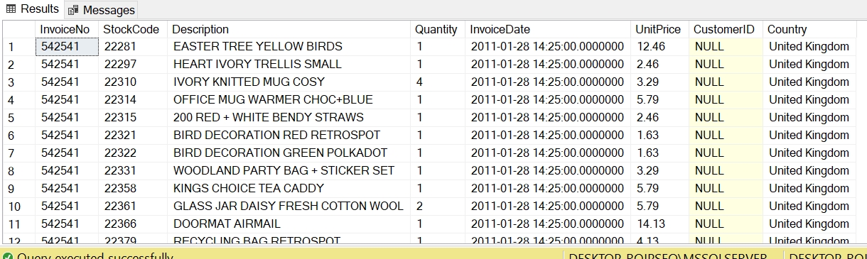
Project analysis slide 2
Dataset Description
Notes:
“Online Retail Data Set ” https://archive.ics.uci.edu/ml/datasets/Online+Retail

Slide 8
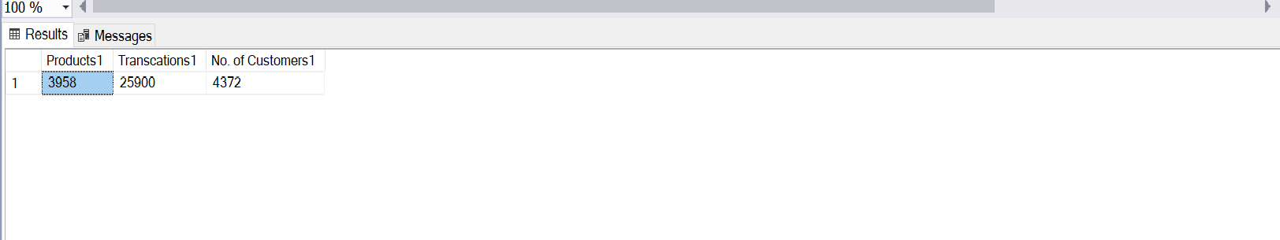
Project analysis slide 2
Analysis of the Data
Initially, the total number of products, transactions, and customers in the data which correspond to the total unique stock codes, invoice number, and customer IDs present in the data were calculated.
Products = 3958 , Transactions = 25900 , No. of customers = 4372
Also, the data contained 5215 duplicate entries (about ~1%) which were removed during the data cleaning process.

Slide 9
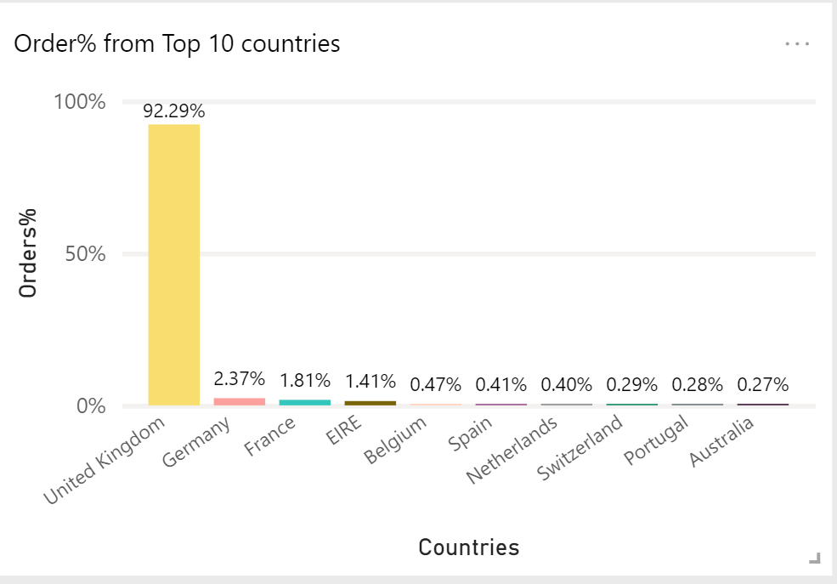
Project analysis slide 2
Highest % of orders according to Country
The UCI Machine Learning repository describes that the data is based on transactions for a UK-based and registered non-store online retail, the percentage of orders from top 10 countries in the data is shown as follows.

Slide 10
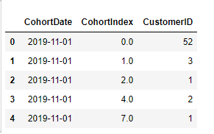
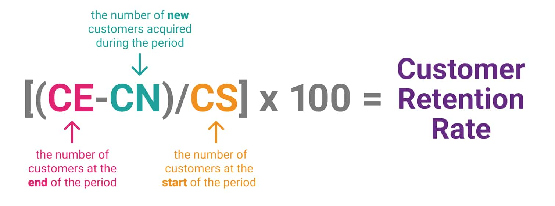
Project analysis slide 2
Cohort Index and Cohort Retention Rate
Cohort Index is an integer representation of the number of months that has passed since the customers first purchase
For example - if cohort index = 1, then the customer made their next purchase in the same month after the first purchase.
Customer Retention Rate is the percentage of existing customers who remain customers after a given period.
Notes:
https://www.customerthermometer.com/img/customer-retention-formula.jpg
https://miro.medium.com/max/582/1*M-9g2sgwHhr4SrMlXn6D9w.png

Slide 11
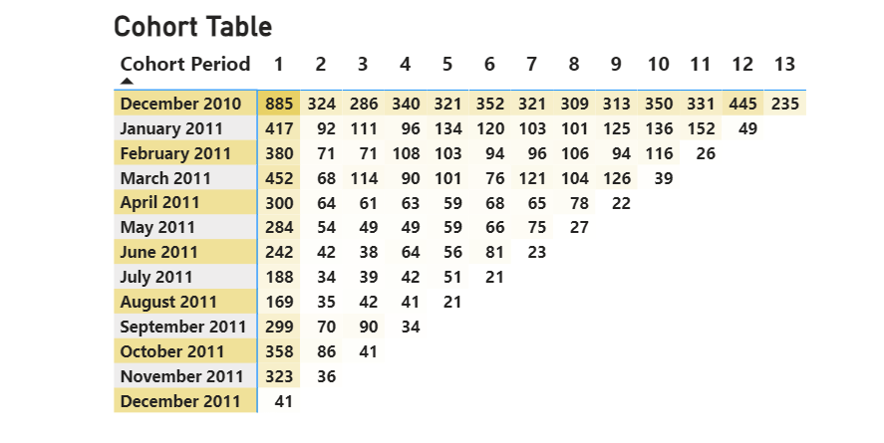
Project analysis slide 2
Insights from Cohort Matrix Analysis
Cohort Table determines the number of transactions made by the customers during the Cohort period according to the Cohort Index.

Slide 12
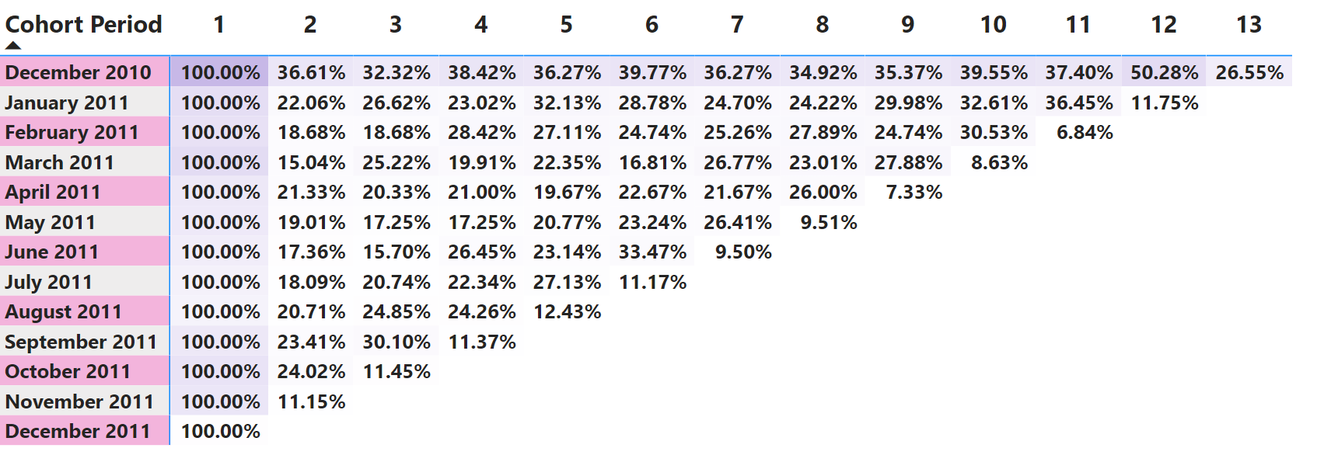
Project analysis slide 2
Insights from Cohort Retention Rate
Cohort Retention Rate defines the percentage of the active customers out of the total customers. Here, in each cohort the number of active customers is dependent upon the Cohort Index 1 values and therefore they are chosen as the cohort sizes.

Slide 13
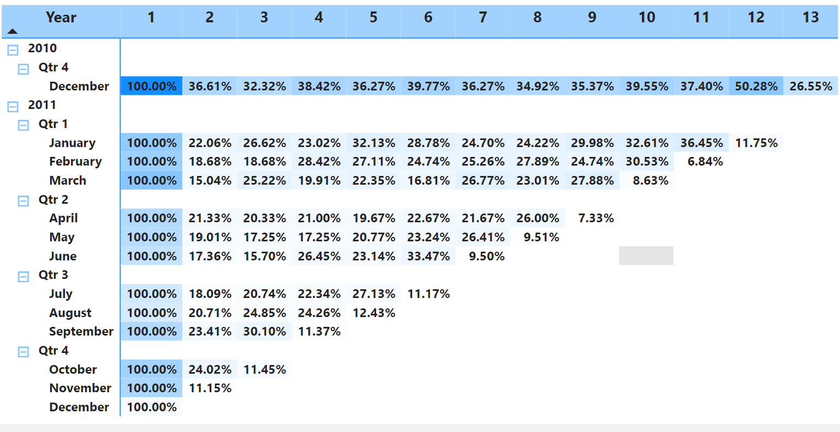
Project analysis slide 2
Cohort Retention Rate By Quarters

Slide 14
Project analysis slide 2
Conclusion & Recommendation
Best Customers –
They are the potential target of new products
Increase company revenue by repeated advertising and heavy discounts are not required for them.
At Risk Customers –
Focused Advertising required to lower the risk of churning.
Discounts should be provided to them
Improve customer care services for them.
New Customers –
Handle with care by improving relationship with them
Enhance the purchasing experience of the customers by providing good quality products, and good customer care services.

Slide 15
Thank You

